Slide 1
Secure data hiding in image using steganography
-----------------------------------Presented By-------------------------------------
Student Name : Repaka Sai Lakshmi
College Name : Maharaj Vijayaram Gajapathi Raj College Of Engineering
Department : Computer Science And Engineering

Slide 2
OUTLINE
Problem Statement
Technology used
Wow factor
End users
Result
Conclusion
Git-hub Link
Future scope

Slide 3
Problem Statement
This project implements image-based steganography to hide secret messages within an image by modifying pixel values. The encryption process encodes the message into the image, while decryption retrieves it using a passcode. It ensures secure communication by concealing information within visual data. The system prevents unauthorized access by requiring the correct passcode for decryption.

Slide 4
Technology used
1. Programming Language: Python 2. Libraries Used:
cv2 (OpenCV) – for image processing
os – for file handling and execution
sys – for system operations
3. Methods & Techniques:
Steganography – Hiding text inside image pixel values
Pixel Manipulation – Modifying RGB values to store secret data
Passcode Protection – Ensuring only authorized users can decrypt the message
Metadata Storage – Saving message length for automatic retrieval during decryption

Slide 5
Wow factors
Lightweight & Simple: Uses basic pixel manipulation without complex algorithms, making it efficient.
Passcode Protection: Ensures only authorized users can decrypt the hidden message.
No External Dependencies: Relies on OpenCV and Python’s built-in functions, making it easy to run.

Slide 6
End users
Cybersecurity Enthusiasts – Individuals interested in data hiding and encryption techniques.
Journalists & Whistleblowers – For securely transmitting confidential information.
Researchers & Students – To explore steganography and digital forensics.
Government & Intelligence Agencies – For secure communication and covert data exchange.
Privacy-Conscious Users – Individuals who want to protect sensitive messages from unauthorized access.

Slide 7
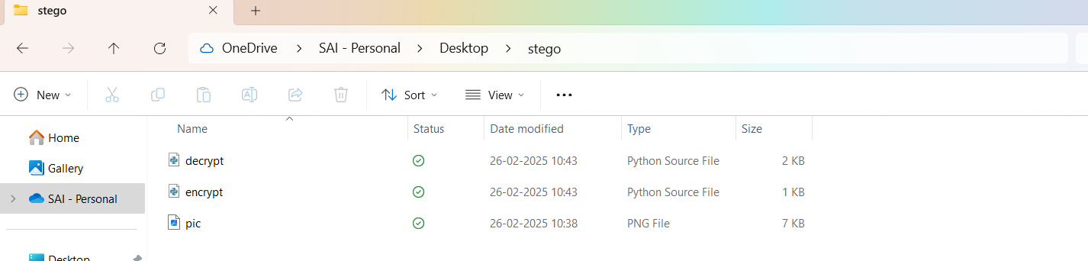
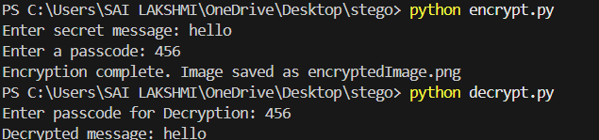
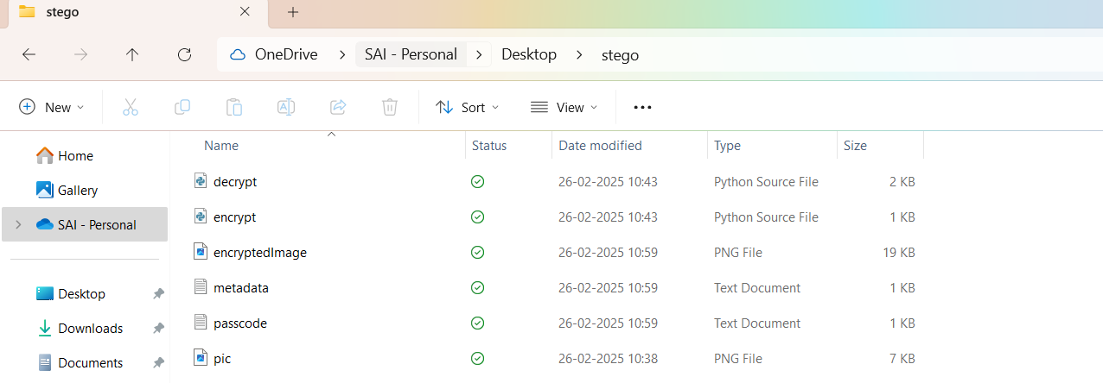
Results

Slide 8
Conclusion
This project successfully implements image-based steganography to securely hide and retrieve secret messages within image pixels. By integrating passcode protection and automatic message retrieval, it enhances security and usability. The system ensures confidential communication while being lightweight and efficient. It stands out due to its simplicity, flexibility, and potential for further enhancements.

Slide 9
GitHub Link
https://github.com/sailakshmi-repaka/Stego.git

Slide 10
Future scope:
Stronger Encryption Techniques – Incorporate AES or RSA encryption along with steganography for added security.
Multi-Format Support – Extend message hiding to video (MP4), audio (WAV), and PDF files for broader applications.
Cloud & Web-Based Implementation – Create a web or mobile app where users can upload images, hide messages, and retrieve them securely.
Enhanced Steganalysis Resistance – Implement advanced encoding techniques to make hidden data harder to detect by attackers.
AI-Based Optimization – Use machine learning to improve data embedding, ensuring minimal distortion and higher security.

Slide 11
THANK YOU

